Slide 1
Classical Simulation of Quantum Circuit
Armando Angrisani · Alexander Schmidhuber · Manuel S. Rudolph · M. Cerezo · Zoë Holmes · Hsin‑Yuan Huang (2024)
Presenter: Steven Ma
Notes:
my name is Steven Ma. Today I’d like to share my plan to reproduce a recent paper, “Classically Estimating Observables of Noiseless Quantum Circuits,” published in 2024. The main question the paper asks is: Can we efficiently estimate expectation values in large quantum circuits using only classical computers, even if the circuits have no noise? (pause)

Slide 2
Motivation
Yet, estimating expectation values of observables is central to quantum algorithms and verification.
Quantum circuits are intractable to simulate classically in general
For many NISQ algorithms, having access to ⟨O⟩ expectation values is highly useful
Key question: Can we estimate ⟨O⟩ efficiently on classical Computer?
Notes:
We know that, in general, simulating quantum circuits is believed to be exponentially hard on classical computers. But in practice, especially in near-term quantum algorithms, we often just need the expectation value of an observable—not the full quantum state. If we can estimate this expectation value classically and efficiently, it helps benchmark quantum devices and understand where quantum advantage really starts. (pause)

Slide 3
Key Idea – Low Weight Pauli Propagation
Work in the Heisenberg picture
After each layer Uj, truncate all Pauli terms with weight > k （weight is number of non-identity terms in expansion)
High‑weight contributions are provably suppressed for locally scrambling layers
Notes:
The main idea in this paper is actually quite simple:
Work in the Heisenberg picture (so we propagate observables backward instead of propagate state forward).
Expand the observable in the Pauli basis, then
After each circuit layer, only keep Pauli terms with weight up to k (where weight means the number of non-identity components in the Pauli string). The paper shows that, in so-called “locally scrambling” circuits, the high-weight Pauli terms contribute exponentially less to the expectation value, so it’s safe to drop them. (pause)

Slide 4
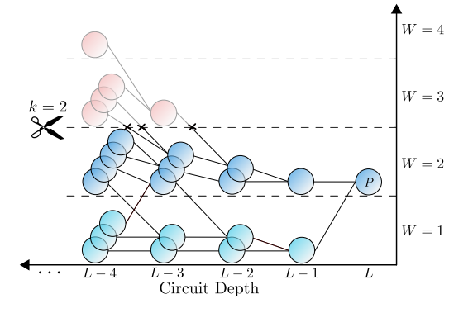
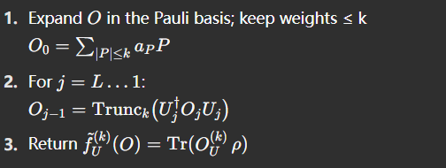
Algorithm Workflow
Notes:
The algorithm works as follows:
Expand the observable in the Pauli basis.
Iteratively propagate this observable backward through each circuit layer, each time applying the circuit unitary and truncating to keep only low-weight Pauli terms.
After all layers, compute the expectation value by taking the trace with the initial state.
On the slide, you can see the tree-like propagation; but because of truncation, the number of terms stays manageable, and the whole process is efficient.

Slide 5
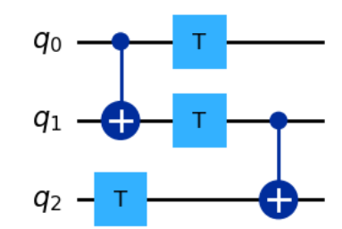
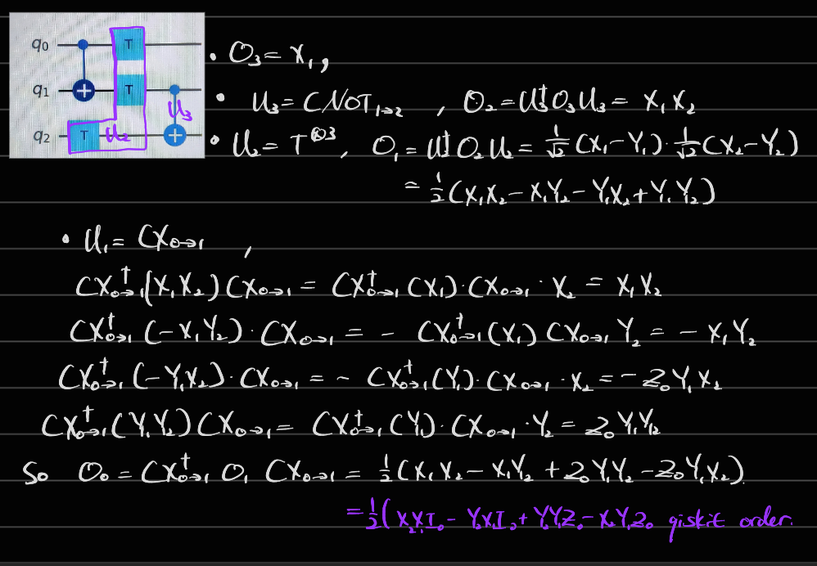
A Simple Example
Notes:
Here is a simple example of 3 qubit 3 layer circuit
Say the observable of interest is X1, as we propagate back, the final observable is …
It contains pauli term of weight equals to 2 and 3.
In larger and more complicated circuitWe can drop the terms with weight = 3 without losing too much information

Slide 6
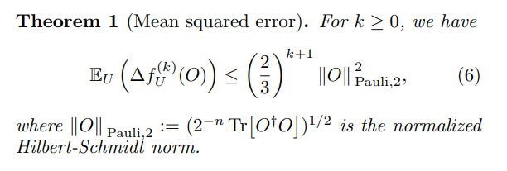
Mean Squared Error
Notes:
The main theorem gives a bound on the mean squared error (MSE),.
That means, if we pick k as something like the logarithm of the error tolerance, the error drops exponentially as k increases. So we get a very good approximation with just moderate k. (pause)
The authors later shows this bound is too conservative.

Slide 7
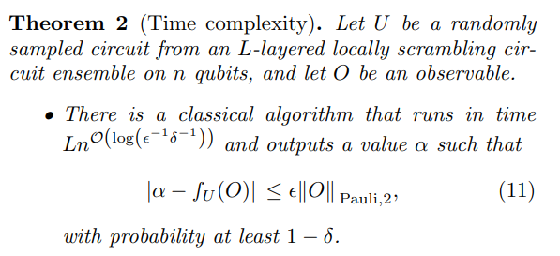
Complexity
Spatial Complexity: O(n^k), k = Θ [ln(1/(ε δ))]
Both the time and space complexity are polynomial in n and L for fixed error ε and failure probability δ.
Notes:
Time and space complexity is roughly n^k times the circuit depth L.
If you want a fixed error (constant epsilon and delta), the whole thing is polynomial in the number of qubits and circuit depth.
On circuit with locally-scrambling property, the algorithm is much more efficient than light-cone state vector method

Slide 8
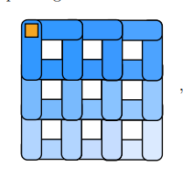
Numerical Benchmark
Tested on a pathological circuit, 64-qubit 2D SU(4) “staircase” circuit.(Lighter color represent earlier execution, 8*8)
Difficult for tensor network simulation method
With k = 3 ⇒ MSE < 10⁻³ in seconds on laptop. MSE estimated from Monte Carlo Simulation of Pauli Paths
Low‑weight propagation outperforms light‑cone on unstructured circuits
Notes:
The authors tried their method on a really tough example: a 64-qubit, 2D circuit (SU(4) gates)
Tensor network is not cable of handling such circuit With just k=3 (keeping only up to 3-body Pauli terms), the MSE drops below 10⁻³,
Even on a standard laptop, the simulation time remains reasonable.

Slide 9
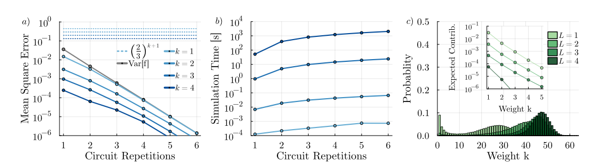
Numerical Benchmark
Notes:
Here are the main numerical results for 64 qubits staircase SU4 circuit.
As the circuit gets deeper, the mean squared error drops exponentially with increasing Pauli truncation weight k. Even with just k=3, the error quickly goes below 10−3.
Simulation times are practical—even for 64 qubits, the runtime is about 10 seconds for three layers on a standard laptop.
Most Pauli operators quickly become high-weight, but their contribution drops off exponentially. This is why the low-weight truncation works so well.
So overall, this method is both accurate and efficient for large circuits.

Slide 10
Reproduction & Extension Plan
Using Python to reproduce Figures similar to previous page.
Perform optimization problems
Notes:
My project is to reproduce the main results and error-vs-depth curves in Python, using the same kind of circuit settings.
I’ll also try to apply this to optimization settings like variational quantum algorithms, to see if the truncation trick can accelerate training. (pause)

Slide 11
Reference
H.-K. Zhang, S. Liu, and S.-X. Zhang, "Absence of barren plateaus in finite local-depth circuits with long-range entanglement," arXiv:2404.07003 (2024).
A. Angrisani, A. Schmidhuber, M. S. Rudolph, M. Cerezo, Z. Holmes, and H.-Y. Huang, "Classically estimating observables of noiseless quantum circuits," arXiv:2409.01706 (2024).
Notes:
The main reference is the 2024 arXiv preprint by Angrisani et al. That’s all for my presentation—thank you for listening! I’m happy to take questions or discuss any details.

Slide 12
Thank you

